Slide 1
Finding Minimum Spanning Trees
Bibliography:
[CLRS]- Chap 23 – Minimum Spanning Trees

Slide 2
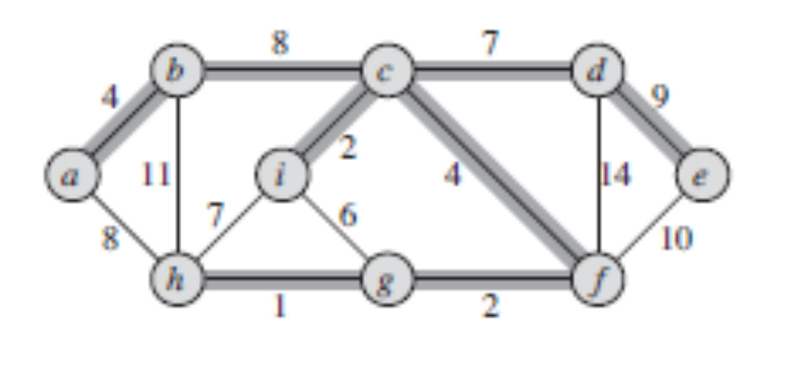
Starting Problem
We have a map of n cities, connected by roads which are in poor condition. For each road, the cost needed for its modernization is known. Create a plan to modernize a subset of all roads, such that any two cities are connected by it and the total cost of the modernization is minimal.
[CLRS] – Fig 23.1
Notes:
[CLRS] – chap 23.1, Fig

Slide 3
The problem in general terms
The problem: Given a connected, undirected graph G=(V;E), and for each edge (u,v) in E, we have a weight w(u,v) specifying the cost to connect u and v. We then want to find a subset T included in E that connects all of the vertices and whose total weight is minimized.
We denote:
Number of vertexes = n = card(V) = |V|
Number of edges = m = card(E)=|E|
For a connected, undirected graph: |V| ≤ |E| ≤ |V|²

Slide 4
A very brute force solution
Backtracking
  Try to generate all subsets T of edges that connect all V nodes, search the one with total minimum cost
Combinations of |E| taken as |V|
No !!! Can we have a better solution ?

Slide 5
Solution starting points
Question: Has the subgraph (V,T) any interesting properties (that could help us in the search for a solution to this problem) ?
  As a first step in finding the solution, we will find and prove such properties

Slide 6
Properties
Property 1: If T is the subset of E that connects all of the vertices and whose total weight is minimized, then the graph A=(V,T) is acyclic.
Proof: if we suppose that A is not acyclic, but it has a cycle: we could remove an edge from the cycle, the vertexes remain connected but the total weight is reduced => T was not the subset of minimum total weight

Slide 7
Definitions: Graph, Tree, Forest
A tree is a connected, acyclic, undirected graph.
A forest is a disconnected, acyclic, undirected graph.
Definition: the subgraph A is called the Minimum-cost Spanning Tree (MST) of graph G=(V,E)

Slide 8
Tree properties
Property 2: The number of edges in a tree T is equal with the number of vertices minus 1. card(T)=card(V)-1
Proof: T is an undirected, acyclic, connected graph. Proof results immediately by induction …

Slide 9
Tree properties
Property 3: There is exactly one path between any two nodes of a tree T.
Proof: T is an undirected, acyclic, connected graph. Proof results immediately by reductio ad absurdum …

Slide 10
Back to the problem …
We know now that the solution to our problem is a Minimum Spanning Tree which has following properties: if the graph has n nodes, the MST contains n-1 edges, and the MST provides exactly one path between any two nodes of the graph

Slide 11
Designing the solution
Apply design by induction:
More difficult in this case: which is the induction hypothesis ?
  “Given a graph with k nodes, we know how to find its MST” - this hypothesis is not good !!!! (find counterexample)
  “Given a graph with n nodes, we know how to find the first k edges to be added to the MST ” – this hypothesis is useful

Slide 12
General solution: Growing a MST
We try growing the MST by adding one edge at a time. We will build a set of edges A, which is, at every moment, a subset of a MST.
Loop invariant: Prior to each iteration, A is a subset of some minimum spanning tree.
At each step, we determine a safe edge (u,v) that we can add to A without violating this invariant, in the sense that A plus (u,v) is also a subset of a minimum spanning tree.

Slide 13
General algorithm for growing a MST
GENERIC-MST
1 A = {};
2 while A does not form a spanning tree
3 find an edge (u,v) that is safe for A
4 A = A + (u,v)
5 return A
Crucial question: How do we find the safe edge needed in line 3 ?

Slide 14
Approaches for growing A
A grows as a single tree Loop invariant: Prior to each iteration, A is a subtree of some minimum spanning tree. (Prim’s algorithm)
A can start as a forest of trees. Loop invariant: Prior to each iteration, A is a subset of some minimum spanning tree. (Kruskal’s algorithm)

Slide 15
Building a MST by growing it as a single tree
Loop invariant: Prior to each iteration, A is a subtree of some minimum spanning tree.
Induction hypothesis: Given a graph, we know how to find a subgraph A with k edges, so that A is a subtree of a MST.
Ek= the set of all edges connecting nodes in A (denoted as the set AV) with nodes of G that are not yet in A (they are in V-AV).
The safe edge = the edge of Ek with the minimum weight.
We have to prove that adding the safe edge leads to a subtree of the MST containing k+1 edges.

Slide 16
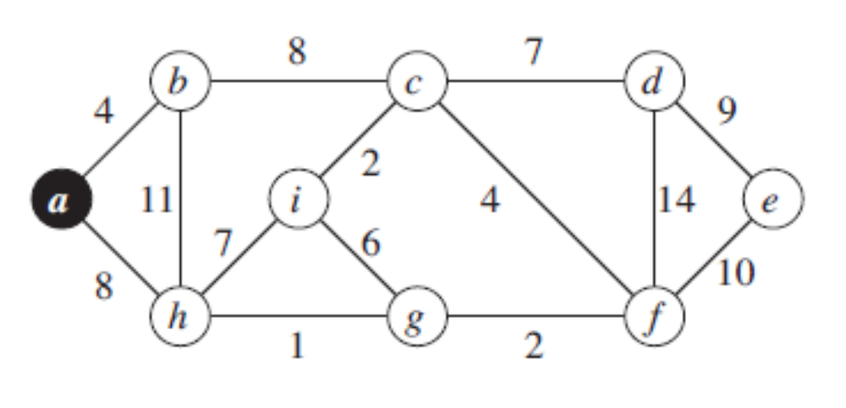
Building a MST by growing it as a single tree - Example
[CLRS – Fig 23.5]

Slide 17
Building a MST by growing it as a single tree - Proof
Induction hypothesis: Given a graph, we know how to find a subgraph A with k edges, so that A is a subtree of a MST.
We also know (see the tree property 3 presented before), that if A has k edges then it has k+1 nodes.
Initialization:
K=0: 1 random start node, 0 edges
K=1: choose the edge with the minimum weight adjacent to the start node. 2 nodes, 1 edge

Slide 18
Building a MST by growing it as a single tree - Proof
Maintenance:
K: suppose A is a subtree of the MST, with k edges. The nodes of A form the set AV.
(u,v)= the minimum cost edge from Ek.
We try to suppose that (u,v) does not belong to MST.
In the MST there is a unique path between u and v. Since u is in AV and v is not in AV, this path will contain an edge (x,y) such that x is in AV and y is not in AV. cost(u,v)<cost(x,y), because (u,v) is the minimum from Ek . If we remove (x,y) from the MST and put (u,v), we obtain another spanning tree, with a smaller cost => the spanning tree containing (u,v) is the MST
=> by adding (u,v) we got a subtree of the MST with k+1 edges

Slide 19
Building a MST by growing it as a single tree - Proof
x
y
u
v
u
Set of vertexes AV
Set of vertexes V- AV

Slide 20
Building a MST by growing it as a single tree - Proof
Termination:
Each iteration adds an edge to A
After |V|-1 iterations all the |V| vertexes are connected, A is the MST of graph G

Slide 21
Prim’s algorithm
  Given G = (V, E). Output: a MST A.
  Randomly select a vertex v
  AV = {v}; A = {}.
  While (AV != V)
  (X) find a vertex u ∈ V-AV that connects to a vertex v ∈ AV such that w(u, v) ≤ w(x, y), for any x ∈ V-AV and y ∈ AV
  AV = AV U {u}; A = A U (u, v).
  EndWhile
  Return A

Slide 22
Comments on Prim’s algorithm
It is a greedy algorithm (it selects the local-best item at every step)
As opposed to typical greedy algorithms that provide approximate results, Prim’s algorithm could be proved that it always finds a minimum cost spanning tree !

Slide 23
Time complexity
The while loop has |V| iterations
  Given G = (V, E). Output: a MST A.
  Randomly select a vertex v
  AV = {v}; A = {}.
  While (AV != V)
  (X) find a vertex u ∈ V-AV that connects to a vertex v ∈ AV such that w(u, v) ≤ w(x, y), for any x ∈ V-AV and y ∈ AV
  AV = AV U {u}; A = A U (u, v).
  EndWhile
  Return A
The running time of the algorithm is |V| multiplied with the running time of the operation (X)

Slide 24
Efficient implementation of Prim’s algorithm ?
The efficiency of the algorithm is determined by the efficiency of the operation denoted by (X) – finding the minimum cost edge (u,v) that unites a vertex v already in the MST (in AV) with a vertex u outside it (V-AV)
Possible solutions to this problem:
  Brute force: test all edges
  Improved: keep the list of vertex candidates in an array
  Better: keep vertex candidates in a priority queue

Slide 25
1. Finding (u,v) – Brute force
  (X) find a vertex u ∈ V-AV that connects to a vertex v ∈ AV such that w(u, v) ≤ w(x, y), for any x ∈ V-AV and y ∈ AV
  min_weight = infinity.
  For each edge (x, y) in E
  if x ∈ V-AV, y ∈ AV, and w(x, y) < min_weight
  u = x; v = y; min_weight = w(x, y);
(X)
  time spent per (X) : Θ(|E|)
  Total time complexity of MST algo: Θ(|V|*|E|)
  Note that |V| ≤ |E| ≤ |V|² => MST algo is O(|V|³)

Slide 26
2 Finding (u,v) - Distance array
In the case when the number of edges is big - near to |V|², the brute force approach is not efficient
Improvement idea: instead of iterating through E in search of the minimum edge, iterate through V in search of the vertex that fulfills the condition.
  BUT: we must be able to test the condition in O(1) !
  Results that: additional data structures are needed to keep for each vertex v the minimum distance from it to any node already in the set of tree nodes AV.
For each vertex v:
d[v] is the min distance from v to any node already in AV
p[v] is the parent node of v in the spanning tree AV

Slide 27
Prim’s algorithm – with distance array
  Given G = (V, E). Output: a MST A.
  For all v ∈ V
  d[v] = infinity; p[v] = null;
  Randomly select a vertex v
  AV = {v}; A = {}; d[v]=0;
  While (AV != V)
  Search d to find u with the smallest d[u] > 0.
  AV = AV U {u}; A = A U (u, p[u]).
  d[u] = 0.
  For each v in adj[u]
  if d[v] > w(u, v)
  d[v] = w(u, v);
  p[v] = u;
  EndWhile
  Return A

Slide 28
Time complexity
  Given G = (V, E). Output: a MST A.
  For all v ∈ V
  d[v] = infinity; p[v] = null;
  Randomly select a vertex v
  AV = {v}; A = {}; d[v]=0;
  While (AV != V)
  Search d to find u with the smallest d[u] > 0.
  AV = AV U {u}; A = A U (u, p[u]).
  d[u] = 0.
  For each v in adj[u]
  if d[v] > w(u, v)
  d[v] = w(u, v);
  p[v] = u;
  EndWhile
  Return A
The while loop has |V| iterations
Θ(|V|)
The loop has maximum |V| iterations
  Total time complexity of MST algo: Θ(|V| *|V|)

Slide 29
3 Finding (u,v) - priority queue
Searching the nearest vertex takes O(|V|) time with distance array
Improvement: Use a Priority Queue
  During execution of the algorithm, all vertices that are not in the tree reside in a min-priority queue Q based on a key attribute. For each vertex , the attribute key is the minimum weight of any edge connecting to a vertex in the tree;
Priority queue operations:
  InitPriorityQueue
  ExtractMin
  ChangeKey
The running time of Prim’s algorithm depends on how we implement the min-priority queue Q !

Slide 30
Complete Prim’s Algorithm
MST-Prim(G, w, r)
Q = G.V;
for each u ∈ Q
key[u] = ∞;
p[u] = null;
key[r] = 0;
while (Q not empty)
u = ExtractMin(Q);
for each v ∈ G.Adj[u]
if (v ∈ Q and w(u,v) < key[v])
p[v] = u;
DecreaseKey(v, w(u,v));
The running time of Prim’s algorithm depends on how we implement the min-priority queue Q !

Slide 31
Implementing min-priority queues
Review: Binary Min-Heaps
A heap is a partial ordered binary tree represented as an array, whose elements satisfy the heap conditions
  As consequence, the highest priority key is always situated on the first position of the array which materializes the heap.

Slide 32
Binary Min-Heaps
1
1
Heap conditions :
ROOT=1
PARENT (i) = i/2
LEFT (i) = 2*i
RIGHT (i) = 2*i+1
2
3
2
9
4
5
6
7
3
4
10
11
MIN-HEAP condition :
A[PARENT(i)] <= A[i]
8
9
10
5
6
8
1 2 3 4 5 6 7 8 9 10
1 2 9 3 4 10 11 5 6 8

Slide 33
Heap - ExtractMin
1
1
N = number of nodes in heap
ExtractMin: Θ(log N)
2
3
2
9
4
5
6
7
3
4
10
11
8
9
10
5
6
8
1 2 3 4 5 6 7 8 9 10
1 2 9 3 4 10 11 5 6 8

Slide 34
Heap - DecreaseKey
1
1
N = number of nodes in heap
DecreaseKey: O(log N)
2
3
2
9
4
5
6
7
3
4
10
11
8
9
10
5
6
8
1 2 3 4 5 6 7 8 9 10
0
1 2 9 3 4 10 11 5 6 8

Slide 35
Complexity of Prim’s Algorithm
MST-Prim(G, w, r)
Q = V[G];
for each u ∈ Q
key[u] = ∞;
p[u] = null;
key[r] = 0;
while (Q not empty)
u = ExtractMin(Q);
for each v ∈ Adj[u]
if (v ∈ Q and w(u,v) < key[v])
p[v] = u;
DecreaseKey(v, w(u,v));
O(V)
Θ(log V)
O(V)
Θ(log V)
Q = a Priority queue based on Heaps
A first rough estimation is O(V*log V+V*V*log V) -> but we can calculate more precise !

Slide 36
Complexity of Prim’s Algorithm
ExtractMin gets called exactly once for every vertex -> contributes O(V*log V)
DecreaseKey gets called overall 2*E times -> contributes O(E*log V)
Complexity of Prim’s algorithm when using a priority queue implemented with heaps
O(V*log V+ E* log V) = O(E*log V)

Slide 37
Final Performance Analysis
MST algorithm using distance array
  O( V* V)
Prim’s algorithm using priority queue based on Heaps
  O(E * log V)
For every graph, V<=E<=V*V
  Sparse graph: E≈V
  Dense graph: E≈V*V
=> Good for dense graphs
=> Good for sparse graphs

Slide 38
Graph representations
Weighted, undirected graph
1
1
2
3
4
1
0
5
6
0
Adjacency
Matrix
5
2
5
0
9
0
2
6
4
3
6
9
0
4
9
4
4
0
0
4
0
3
1
2,5
3,6
Adjacency
Lists
2
1,5
3,9
3
1,6
2,9
4,4
4
3,4

Slide 39
Influence of graph representations on MST algorithms
Prim’s algorithm using priority queue based on Heaps should not use adjacency matrixes for graph representation, otherwise it becomes O(V*V*log V) !

Slide 40
Review: Prim’s algorithm - Complexity
Queue Graph | Distance Array | Min-Heap PQ
Adjacency Matrix | V*V (good if graph is dense) | V*V*logV
Adjacency Structure | V*V+E*logV | E*log V (good if graph is sparse: E<<V*V)

Slide 41
Review: Prim’s algorithm - Conclusion
A solution to a problem is good, if:
  The algorithm is correct
  The implementation uses adequate data structures such that they help make the most out of the algorithm

Slide 42
Conclusions
Steps for solving algorithmic problems
  Identify the abstract model behind the problem story. Make clear what we are looking for
  Identify and prove properties of the solution that may be helpful in finding it
  Design the algorithm “in the large” (without worrying about low-level implementation details), prove it
  Refine the details of the algorithm, search for solutions to reduce complexity
  Decide the final implementation details

Slide 43
Bibliography
Minimum Spanning Trees. Prim’s algorithm [CLRS chap 23]
Review: Heaps. Priority Queues [CLRS chap 6]

